Slide 1
Tesla Coil Guitar Amp
Griffin Rzonca and David Mengel
1

Slide 2
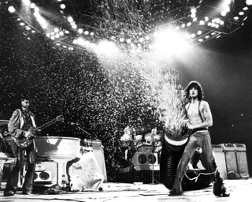

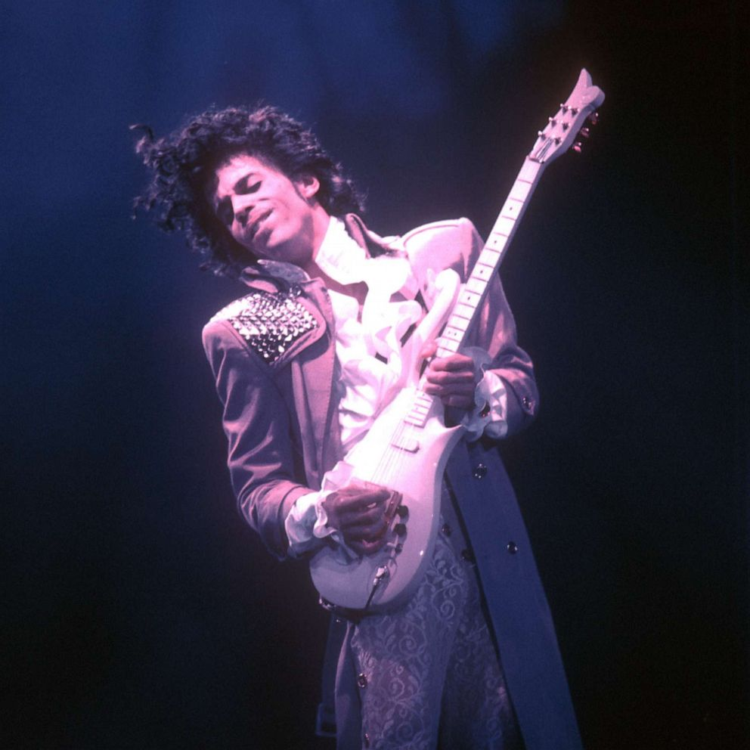
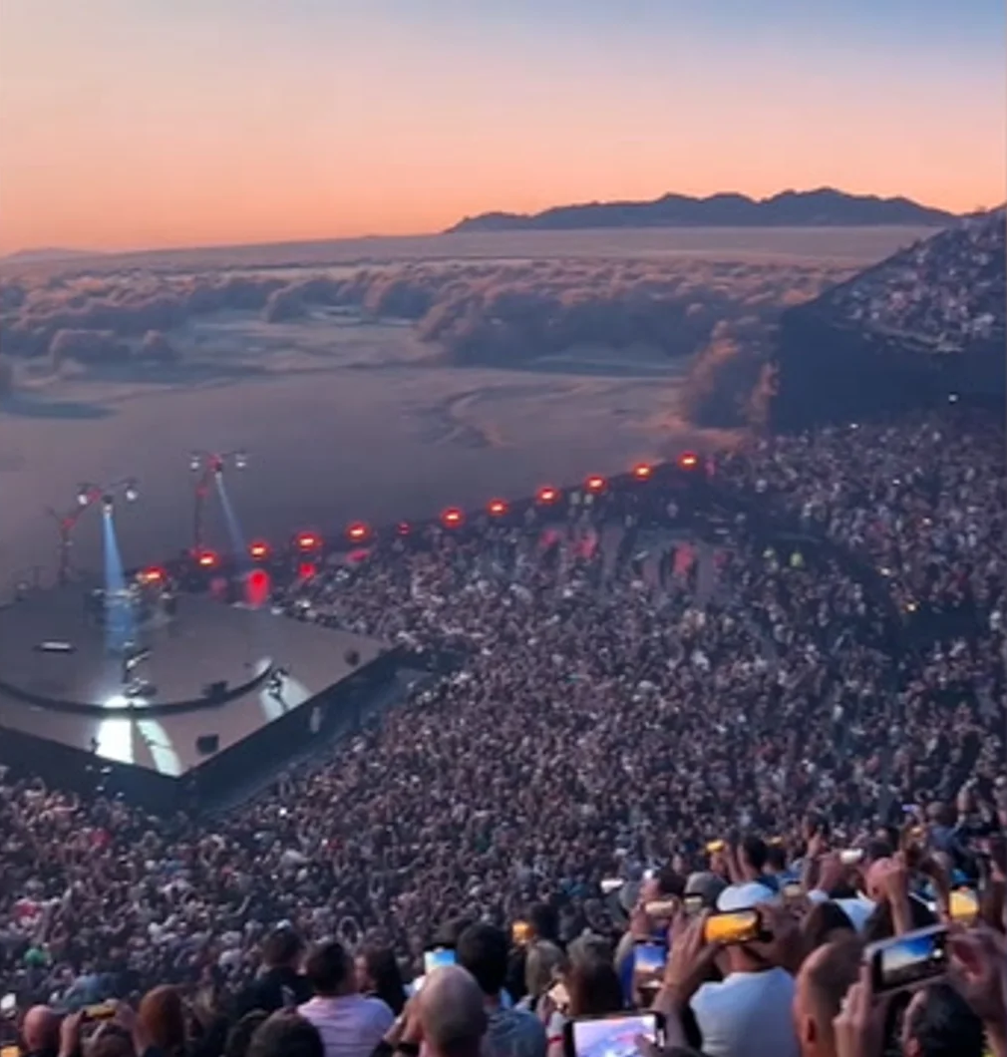
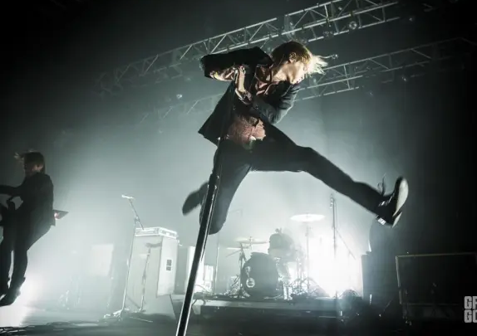
Any Fans of Live Music?
2
Notes:
Griffin

Slide 3
Musicians are constantly searching for new forms of expression, so…
Can we make live performances more exciting?
3
Notes:
Griffin

Slide 4
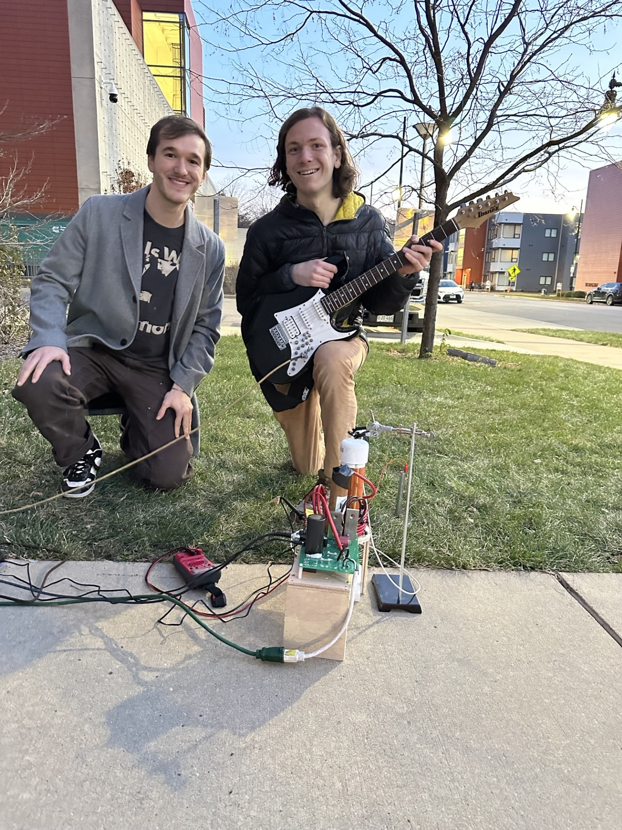
Introduction
Yes!
Make a guitar that controls a tesla coil
Allow users to play music and create dazzling effects while doing it
4
Notes:
Griffin

Slide 5
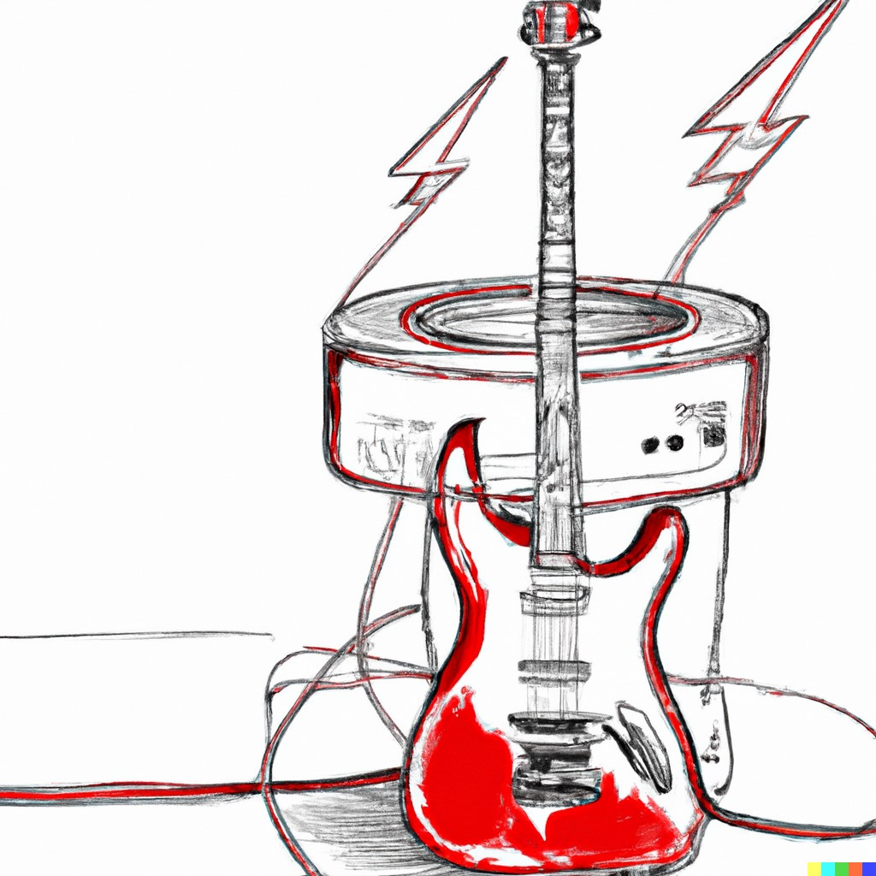
Objective
Use a guitar to control a tesla coil and create sparks that play music!
High Level Requirements:
Create sparks
Make sparks create different audio tones
Control notes of sparks with guitar
5
Notes:
Griffin

Slide 6
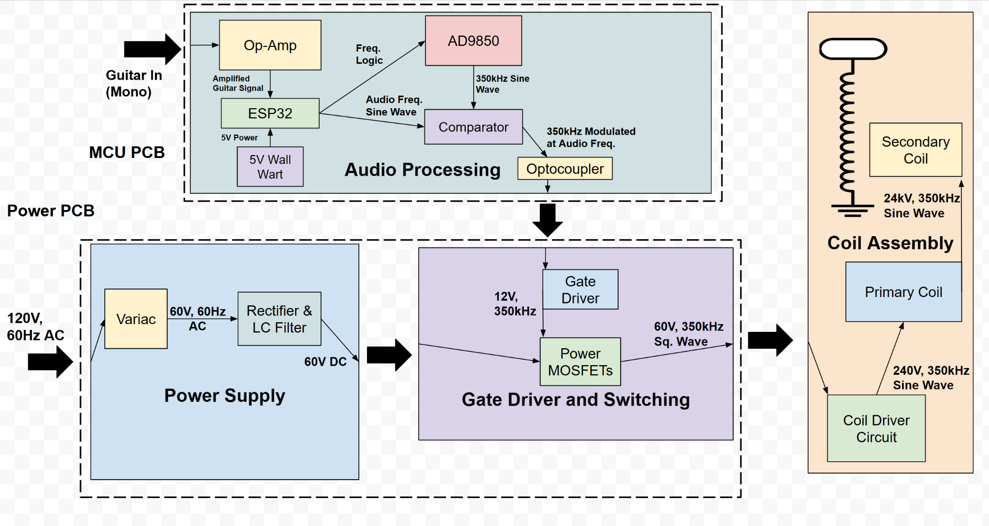
Design - Overview
6
Notes:
David

Slide 7
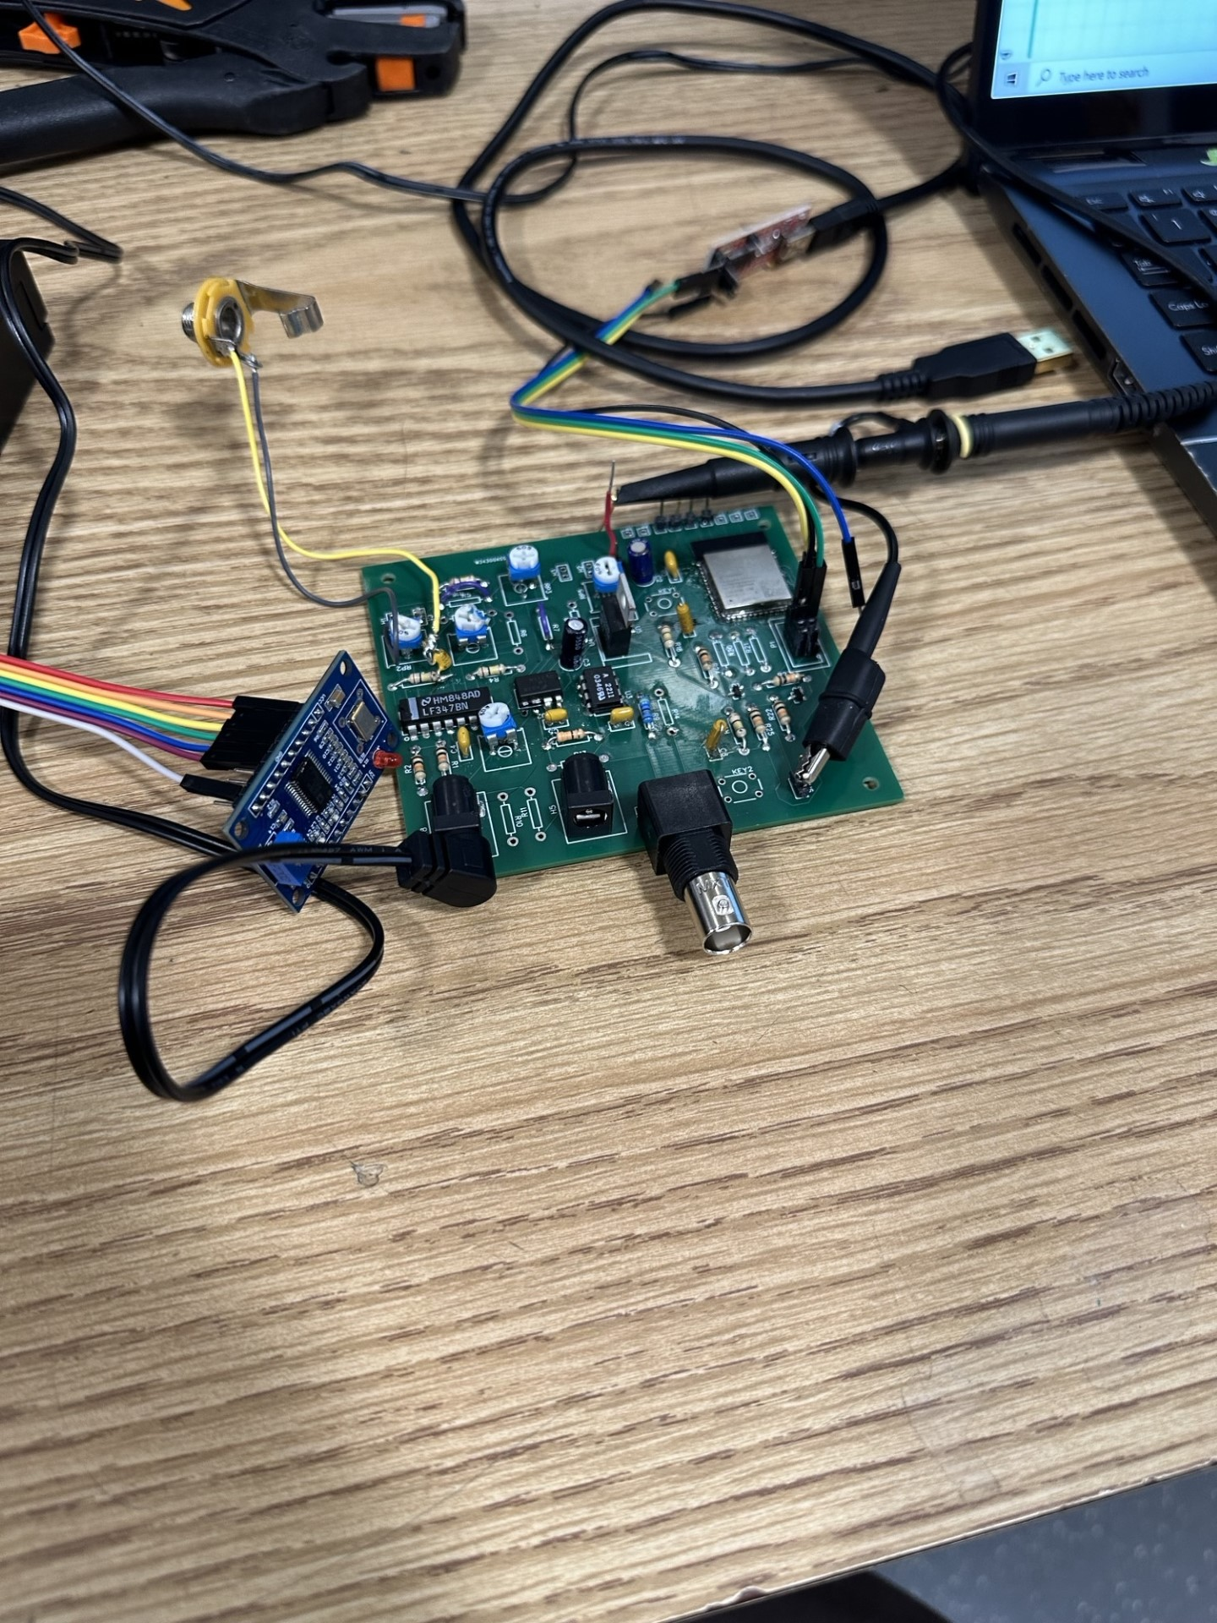
Design - Audio Board
Objective: Process Guitar Output to Control Switching
Guitar sine wave amplified and and sent into a comparator
Microcontroller used to control resonant frequency generator
Pulse-Width Modulation to create control signal
Optocoupler Isolation for safety
7

Slide 8
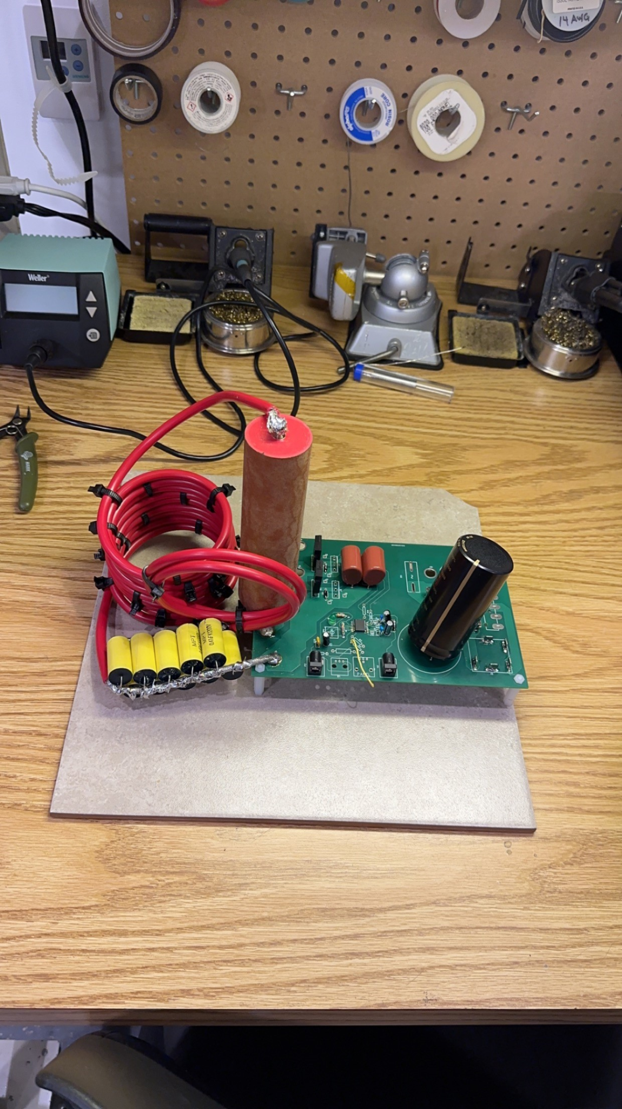
Design - Power Board
Objective: Convert wall power to usable power for tesla coil
Plugged into wall, rectified and filtered -> Steady DC at safe 20V
Power then switched on and off at resonant frequency - this creates gain so the tesla coil can spark!
Developed specialized tank circuit, raises voltage even higher, fed into coil to create sparks!
8

Slide 9
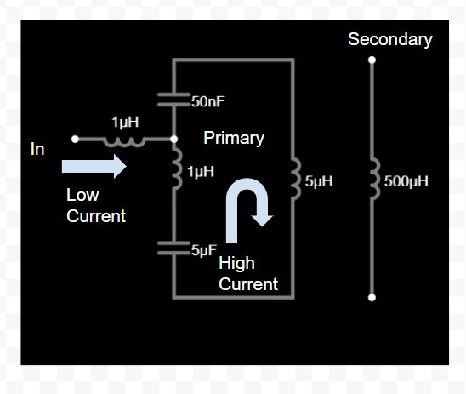

Specialized Tank Circuit
9
Notes:
David

Slide 10
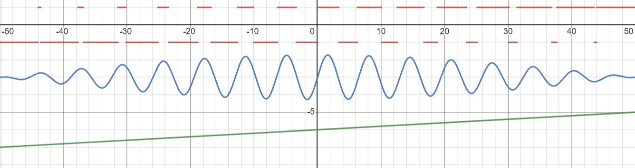
A Different Kind of Pulse-Width Modulation
PWM is used to adjust level of Fundamental, not DC bias
Pulse Wave
Fundamental
DC
10
Notes:
David

Slide 11

Conclusion
Project was a Success!
Design allows for operation at high power
Novel Circuit Topology
Parallel resonant Tank Circuit for low transistor stress
Never done before
Special thanks to Dr. Fliflet, Dr. Banerjee, and Jason
11

